Slide 1
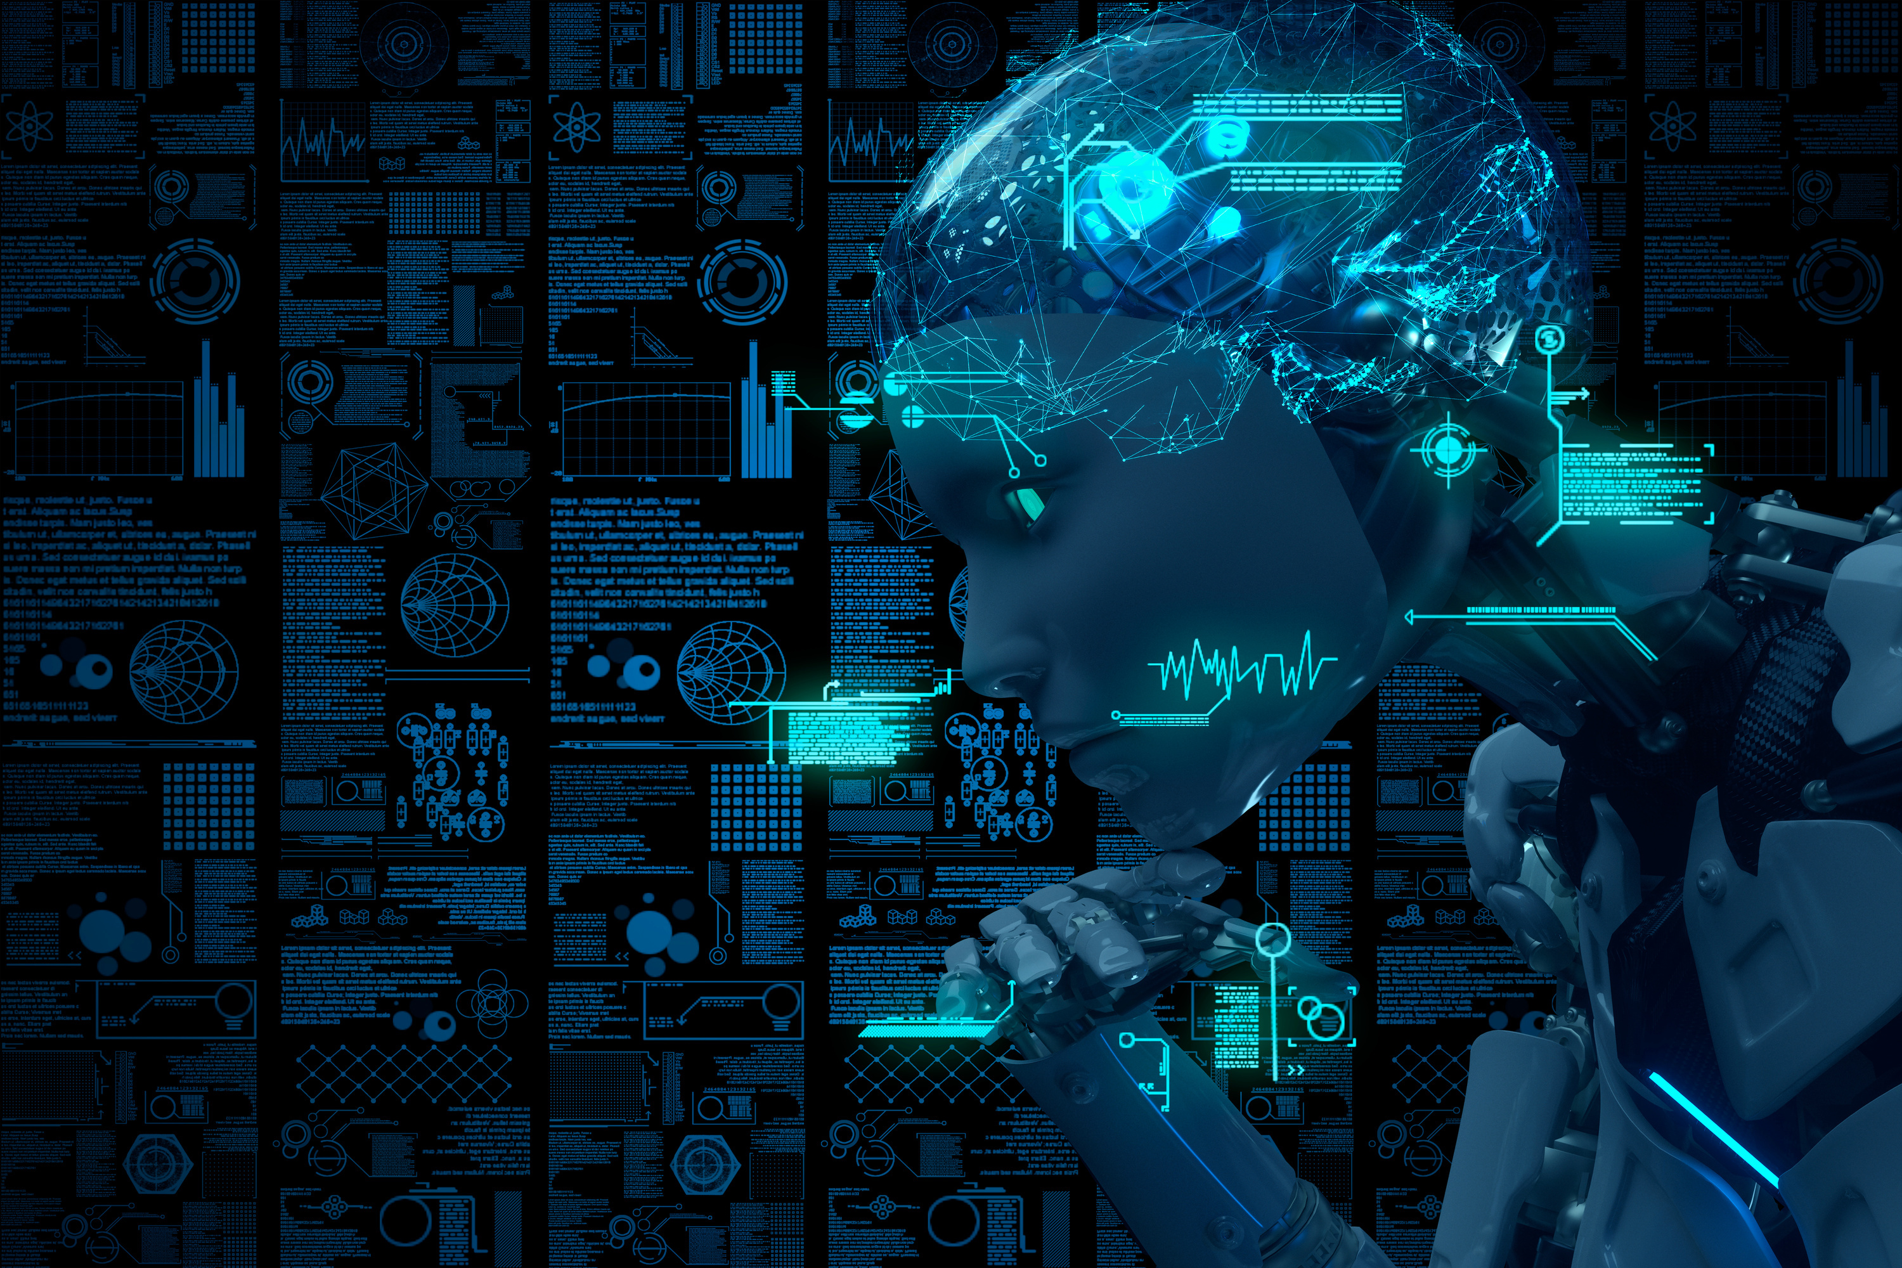

Trends In Computer Science
4C0SC008C
Machine Learning Threats And Opportunities
And Opportunities
Group No-2
Describe and compare two different machine-learning techniques
FULL NAME | UOW NUMBER | STUDENT ID | SUB-TOPIC NUMBER
Venuja Kithmin | W2053273 | 20221294 | 2-B
Dineth Jayasuriya | W2052288 | 20220601 | 2-A
Eshan Perera | W2053271 | 20220002 | 2-C
Rumeth Perera | W2053260 | 20220814 | 2-D
Bihandu Wijesiri | W2053263 | 20222346 | 2-E

Slide 2

Introduction
Machine learning allows computers to learn without programming
Two categories of techniques: supervised and unsupervised learning
Technique depends on domain characteristics, data, and outcomes

Slide 3
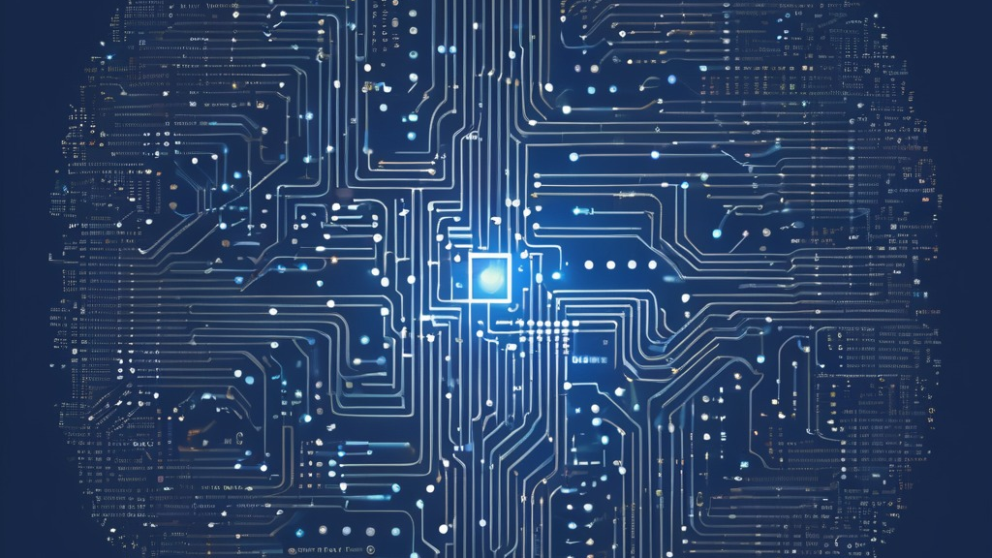
Supervised Learning
Uses labeled data to build predictive models
Learns input-output relationships to classify new data
Two problem types addressed:
1. Classification - Categorical target variable
2. Regression - Continuous target variable

Slide 4
Supervised Learning Algorithms
Logistic Regression - Predicts categories
Linear Regression - Predicts unknowns from known data
Polynomial Regression - Determines dependent/independent relationships
Support Vector Machines - Separates example groups
Decision Trees - Breaks problems into simple decisions
Neural Networks - Connects units to model patterns from examples

Slide 5

Unsupervised Learning
Well suited when human experts don't know what to look
It is applied to unlabeled datasets
Prioritizes descriptive modeling and pattern discovery over prediction.
Main difference in the training process as outputs are unknown in unlabeled data

Slide 6
Types Of Unsupervised Learning
Clustering
Groups unlabeled examples based on similarities
K-means partitions into clusters by distance to centroids
2) Association Analysis
Discovers relationships between variables in large datasets
Apriori

Slide 7

Conclusion
Strengths of unsupervised learning
Explores complex unlabeled data
Uncovers hidden patterns and associations
2) Strengths of supervised learning
Can produce more accurate outputs with labeled data
Considerations when choosing a technique

Slide 8

References
Machine learning. (n.d.). Google Books. https://books.google.lk/books?hl=en&lr=&id=4VVDEAAAQBAJ&oi=fnd&pg=PT25&dq=unsupervised+machine+learning+introduction&ots=OLfgEzQ7nN&sig=2W37HZ6Dr1iGdLsGuY1NCbDCIBM&redir_esc=y#v=onepage&q=unsupervised%20machine%20learning%20introduction&f=fal
Baby, D., Devaraj, S.J., Mathew, S., Anishin Raj, M.M., Karthikeyan, B., 2020. A Performance Comparison of Supervised and Unsupervised Image Segmentation Methods. SN computer science 1. https://doi.org/10.1007/s42979-020-00136-9

